Slide 1
Early Detection of Diabetes Onset using Clinical and Lifestyle Data with Predictive Analytics
PRESENTED BY B.TECH 4TH YEAR DATA SCIENCE – B
N Ganesh 22C91A6796
N MANISH 22C91A6791
K Uday Kumar 22C91A6765
K ravi 22C91A6762

Slide 2
INTRODUCTION
Diabetes mellitus is one of the most rapidly growing chronic diseases worldwide, posing a serious threat to public health and economic development. It is a metabolic disorder characterized by high blood glucose levels resulting from insufficient insulin production, impaired insulin action, or both. If not diagnosed and managed at an early stage, diabetes can lead to severe complications such as cardiovascular diseases, kidney failure, vision loss, and nerve damage. Therefore, early detection and timely intervention are crucial to reduce the long-term impact of this disease.
In recent years, the rapid growth of digital healthcare systems and electronic medical records has led to the availability of large volumes of clinical and lifestyle data. These datasets include medical history, laboratory test results, physical activity patterns, dietary habits, body mass index (BMI), age, family history, and other behavioral factors. Such diverse and comprehensive data provides valuable insights into an individual’s health status and risk profile for diabetes.

Slide 3
Types of Diabetes
1. Type 1 Diabetes
Type 1 diabetes is an autoimmune disorder in which the body’s immune system mistakenly attacks and destroys insulin-producing cells in the pancreas. As a result, the body produces little or no insulin. This type usually develops during childhood or adolescence but can also occur in adults. People with Type 1 diabetes require lifelong insulin therapy to survive.
2. Type 2 Diabetes
Type 2 diabetes is the most common form of diabetes and occurs when the body becomes resistant to insulin or does not produce enough insulin. It is strongly associated with unhealthy lifestyle habits such as poor diet, lack of physical activity, obesity, and stress. This type usually develops in adults but is increasingly seen in younger individuals due to changing lifestyles. Type 2 diabetes can often be managed through lifestyle changes, oral medications, and sometimes insulin.
3. Gestational Diabetes
Gestational diabetes occurs during pregnancy in women who have never had diabetes before. It is caused by hormonal changes that affect insulin function. Although it usually disappears after childbirth, women with gestational diabetes have a higher risk of developing Type 2 diabetes later in life. It can also affect the health of both mother and baby if not properly managed.

Slide 4
Proposed Framework for Early Detection of Diabetes
1. Data Collection
This is the first step of the framework, where relevant data is gathered from multiple sources, such as:
Electronic Health Records (EHRs)
Hospital databases
Health surveys
Wearable devices
Self-reported lifestyle information
Data includes:
Age, gender, family history
Blood glucose levels, blood pressure, cholesterol
Body Mass Index (BMI)
Physical activity, diet, smoking, alcohol habits
2. Data Preprocessing
Raw data may contain missing values, noise, and inconsistencies. Therefore, preprocessing is necessary to improve data quality.
This stage involves:
Handling missing values
Removing duplicates
Noise filtering
Normalization and scaling
Encoding categorical variables

Slide 5
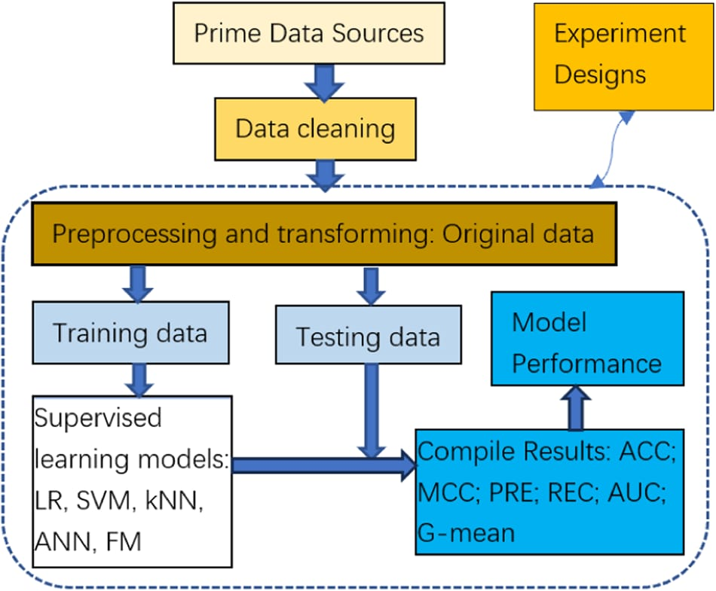
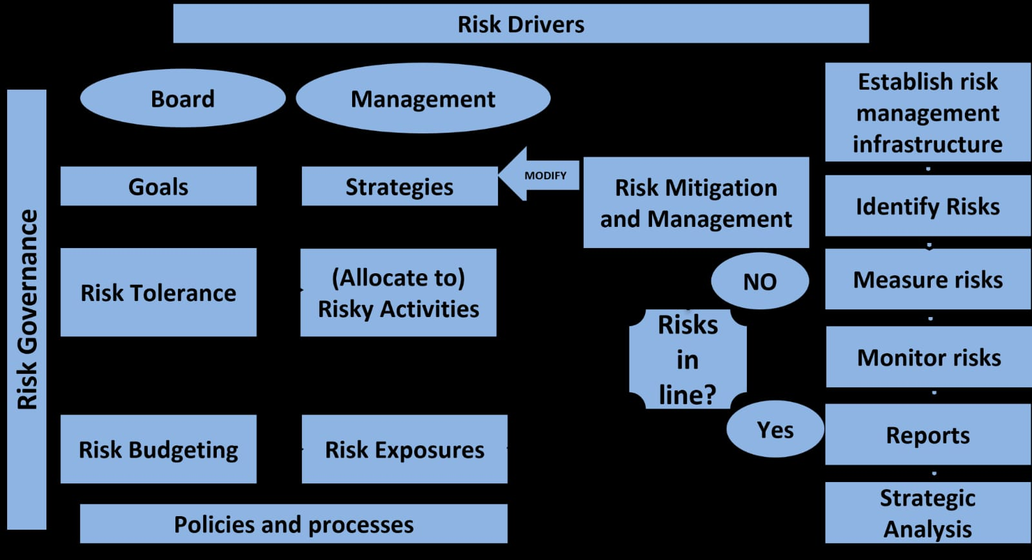
MACHINE MODEL
FRAMEWORK

Slide 6
KEY COMPONENTS OF Proposed System
1. Data Source Component
This component is responsible for collecting data from different sources.
It includes:
Hospital and clinic records
Laboratory reports
Health surveys
Wearable devices
Personal health records
It provides both clinical data and lifestyle data required for analysis.
2. Data Management Component
This component stores and organizes the collected data securely.
Functions include:
Database management
Data storage
Data retrieval
Data security and privacy
It ensures data is safe and easily accessible.

Slide 7
COMMON MODELS
1. Logistic Regression
A widely used statistical model for binary classification.
Predicts whether a person is diabetic or non-diabetic.
Simple, fast, and easy to interpret.
Works well with structured medical data.
Use: Baseline model for comparison.
2. Decision Tree
A tree-like structure that makes decisions based on rules.
Easy to understand and visualize.
Handles both numerical and categorical data.
Can overfit if not properly tuned.
Use: Rule-based medical decision support.
3. Random Forest
An ensemble model made of multiple decision trees.
Improves accuracy and reduces overfitting.
Handles missing values and noisy data well.

Slide 8
IMPLEMENTATION CHALLENGES
Data Quality: Incomplete or biased historical data for modeling.
Integration: Aligning models with IT systems and business processes.
Regulatory Compliance: Frequent updates and audits.
Model Risk: Overfitting, validation issues, or black-box ML models.
Economic Factors: Handling cycles, pandemics (e.g., COVID-19 spikes in defaults).
Solutions: Use AI for better predictions, regular back-testing.

Slide 9
CONCLUSION
Early detection of diabetes plays a vital role in reducing the long-term health complications associated with the disease. This study focused on predicting the onset of diabetes by analyzing clinical and lifestyle data using predictive analytics and machine learning techniques. By integrating medical indicators such as blood glucose levels, BMI, blood pressure, and family history with lifestyle factors like physical activity, diet, and smoking habits, the proposed system provides a comprehensive approach to risk assessment.
The developed predictive models demonstrated that data-driven techniques can effectively identify individuals at high risk of developing diabetes at an early stage. Machine learning algorithms such as Logistic Regression, Random Forest, Support Vector Machine, and Neural Networks showed promising performance in classifying individuals based on their risk levels. Among these, ensemble and boosting methods achieved higher accuracy, highlighting their suitability for healthcare prediction systems.
The results indicate that the proposed framework can serve as a reliable decision-support tool for healthcare professionals and individuals. Early risk identification enables timely medical intervention, personalized lifestyle recommendations, and continuous health monitoring. This proactive approach not only improves patient outcomes but also helps in reducing healthcare costs and the burden on medical systems.
In the future, the system can be enhanced by incorporating real-time data from wearable devices, genetic information, and advanced deep learning techniques. Additionally, integrating the model with mobile health applications and hospital information systems can improve accessibility and scalability. Overall, predictive analytics offers a powerful and efficient solution for the early detection and prevention of diabetes, contributing to better public health management and improved quality of life.

